Slide 1

KidTask: Making Chores Fun for Kids
A Java GUI application that transforms daily tasks into an engaging game where children earn points, level up, and unlock wishes through completing chores and homework.

Slide 2

Meet the Challenge
The Problem We're Solving
Mrs. Ayşe struggles to motivate her son Can to complete his homework and chores. Traditional reward systems feel disconnected and fail to engage him. She needs a fun, visual system that tracks progress and makes tasks feel like achievements rather than obligations.
"How can we make daily responsibilities exciting for children while giving parents effective oversight?"

Slide 3

Our Solution: Gamified Task Management
Task Tracking
Wish System
Children view and complete daily and weekly tasks with clear due dates and point values
Kids add desired rewards that unlock as they level up and earn points
Progress Gamification
Parental Control
Visual progress bars and level systems keep children motivated and engaged
Parents approve tasks and wishes while monitoring their child's progress in real-time

Slide 4



User Roles and Capabilities
Child User
Parent User
Teacher User
View assigned tasks
Create and assign tasks
Add school-related tasks
Mark tasks complete
Approve completed work
Rate completed homework
Add wish items
Review and approve wishes
Provide academic feedback
Track points and level
Monitor overall progress
Track student engagement

Slide 5
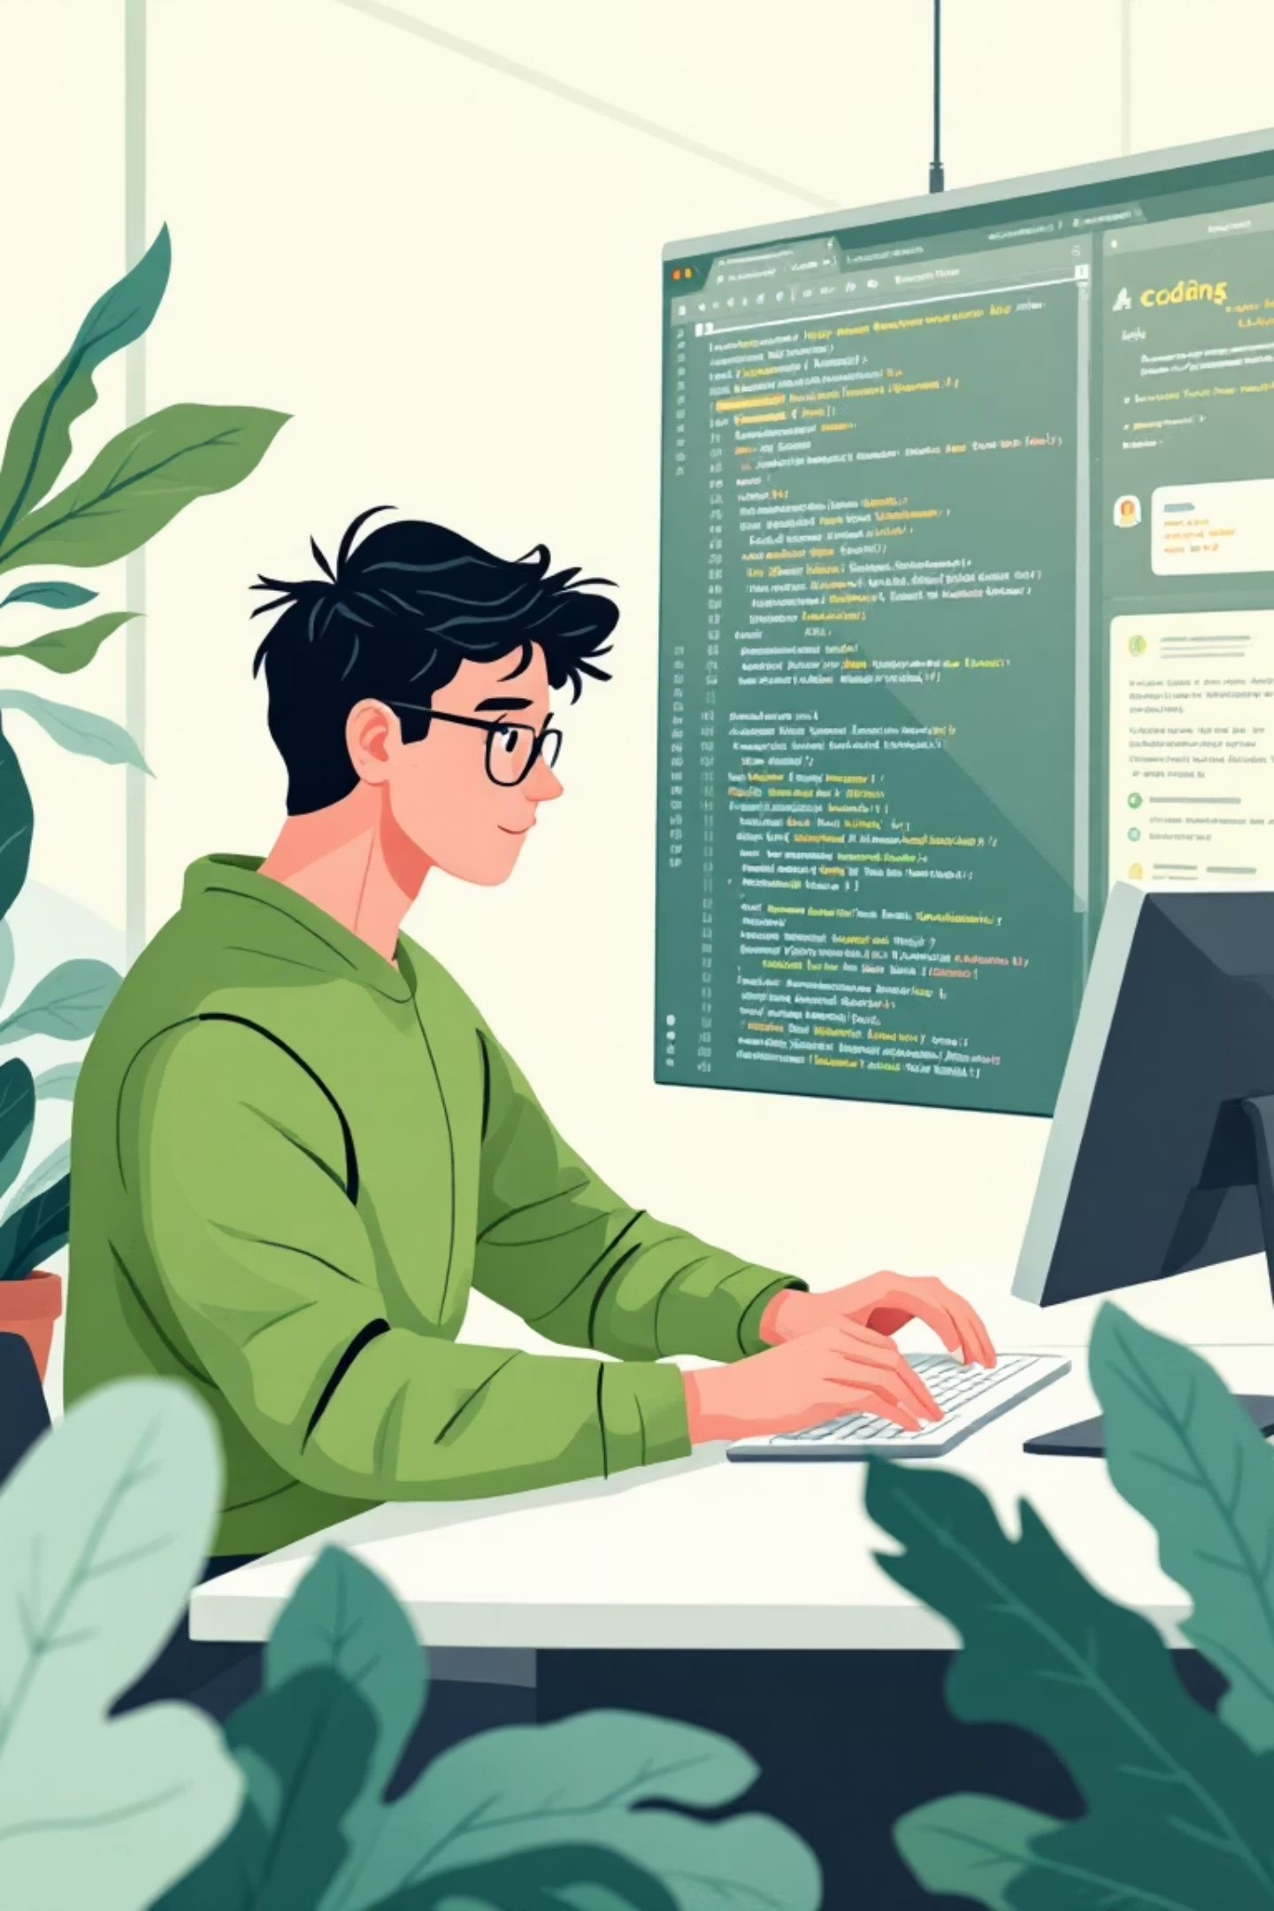



Behind the Scenes: AI Development Process
This project demonstrates effective human-AI collaboration. We used AI coding assistants while maintaining critical oversight through prompt engineering and manual refinement.
Prompt Design
Crafted specific requests for GUI components and data handling logic
Output Analysis
Evaluated AI-generated code for correctness, efficiency, and edge cases
Human Revision
Manually refined code to fix bugs and enhance user experience

Slide 6
AI Interaction Case Study: GUI Design with Canva
01
02
Initial Prompt
AI Output Analysis
I uploaded the document and asked for "can you create a comprehensive GUI design compatible with childrens usage and cover all of the features in the file."
Copilot generated functional buttons but with standard sizing and professional fonts inappropriate for the target age group. There was some missing buttons and placeholders.
03
04
Human Intervention
Result
I reviewed and identified some missing parts then asked AI for more revisions. Added guiding features such as placeholders for buttons and adjusted buttons coloring.
Engaging, age-appropriate interface that children find intuitive and enjoyable to use.

Slide 7
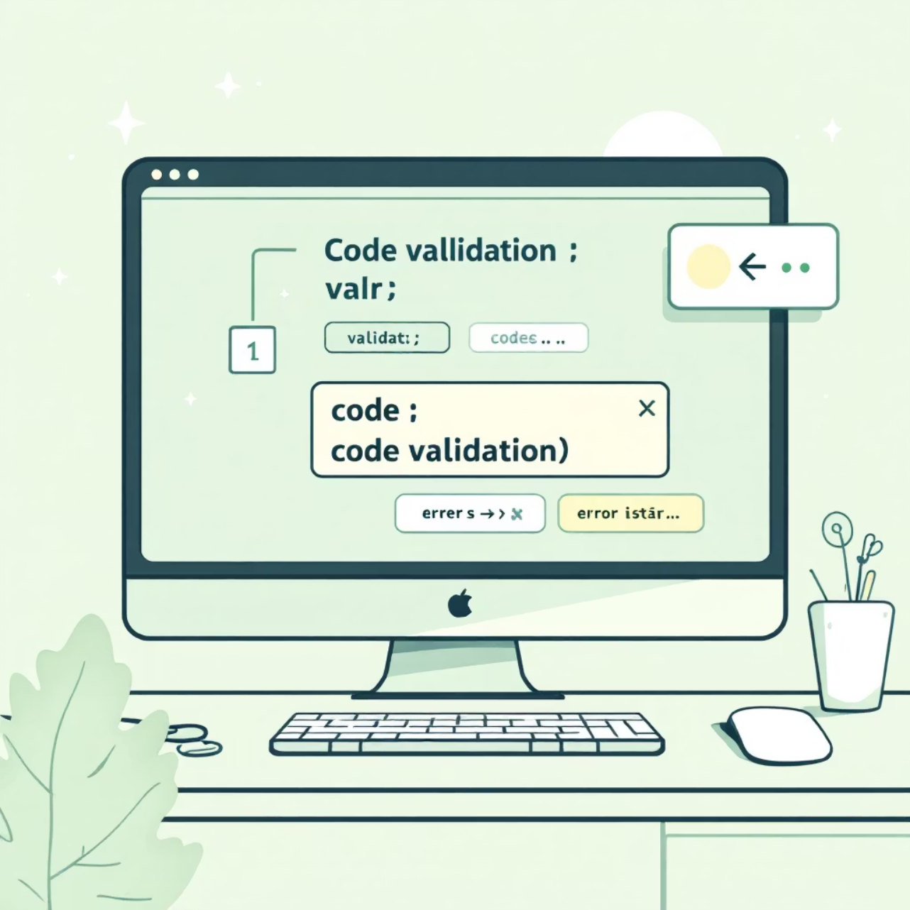
AI Interaction Case Study: Data Validation(Cursor)
Challenge: Unseen Button Placeholder
Prompt Used:
The confirmation button looks bad to the parent and teacher. It doesn't look right, or rather, the text doesn't appear at all.
AI Response: Adjusted the size and coloring so it would be more visible.
Our Refinement: Revised the project and adjusted UI interactions according to what asked.
Impact: Improved application reliability and trustworthiness by preventing crashes during data entry

Slide 8
Technical Architecture
Core Technology
Data Persistence
Development Tools
Language: Java 11+
Storage: File-based system using JSON format
IDE: Eclipse
GUI Framework: JavaFX for modern, responsive interfaces with CSS styling support
Version Control: GitHub repository with documented commit history
Files: Tasks.json, Wishes.json, Users.json for data management

Slide 9
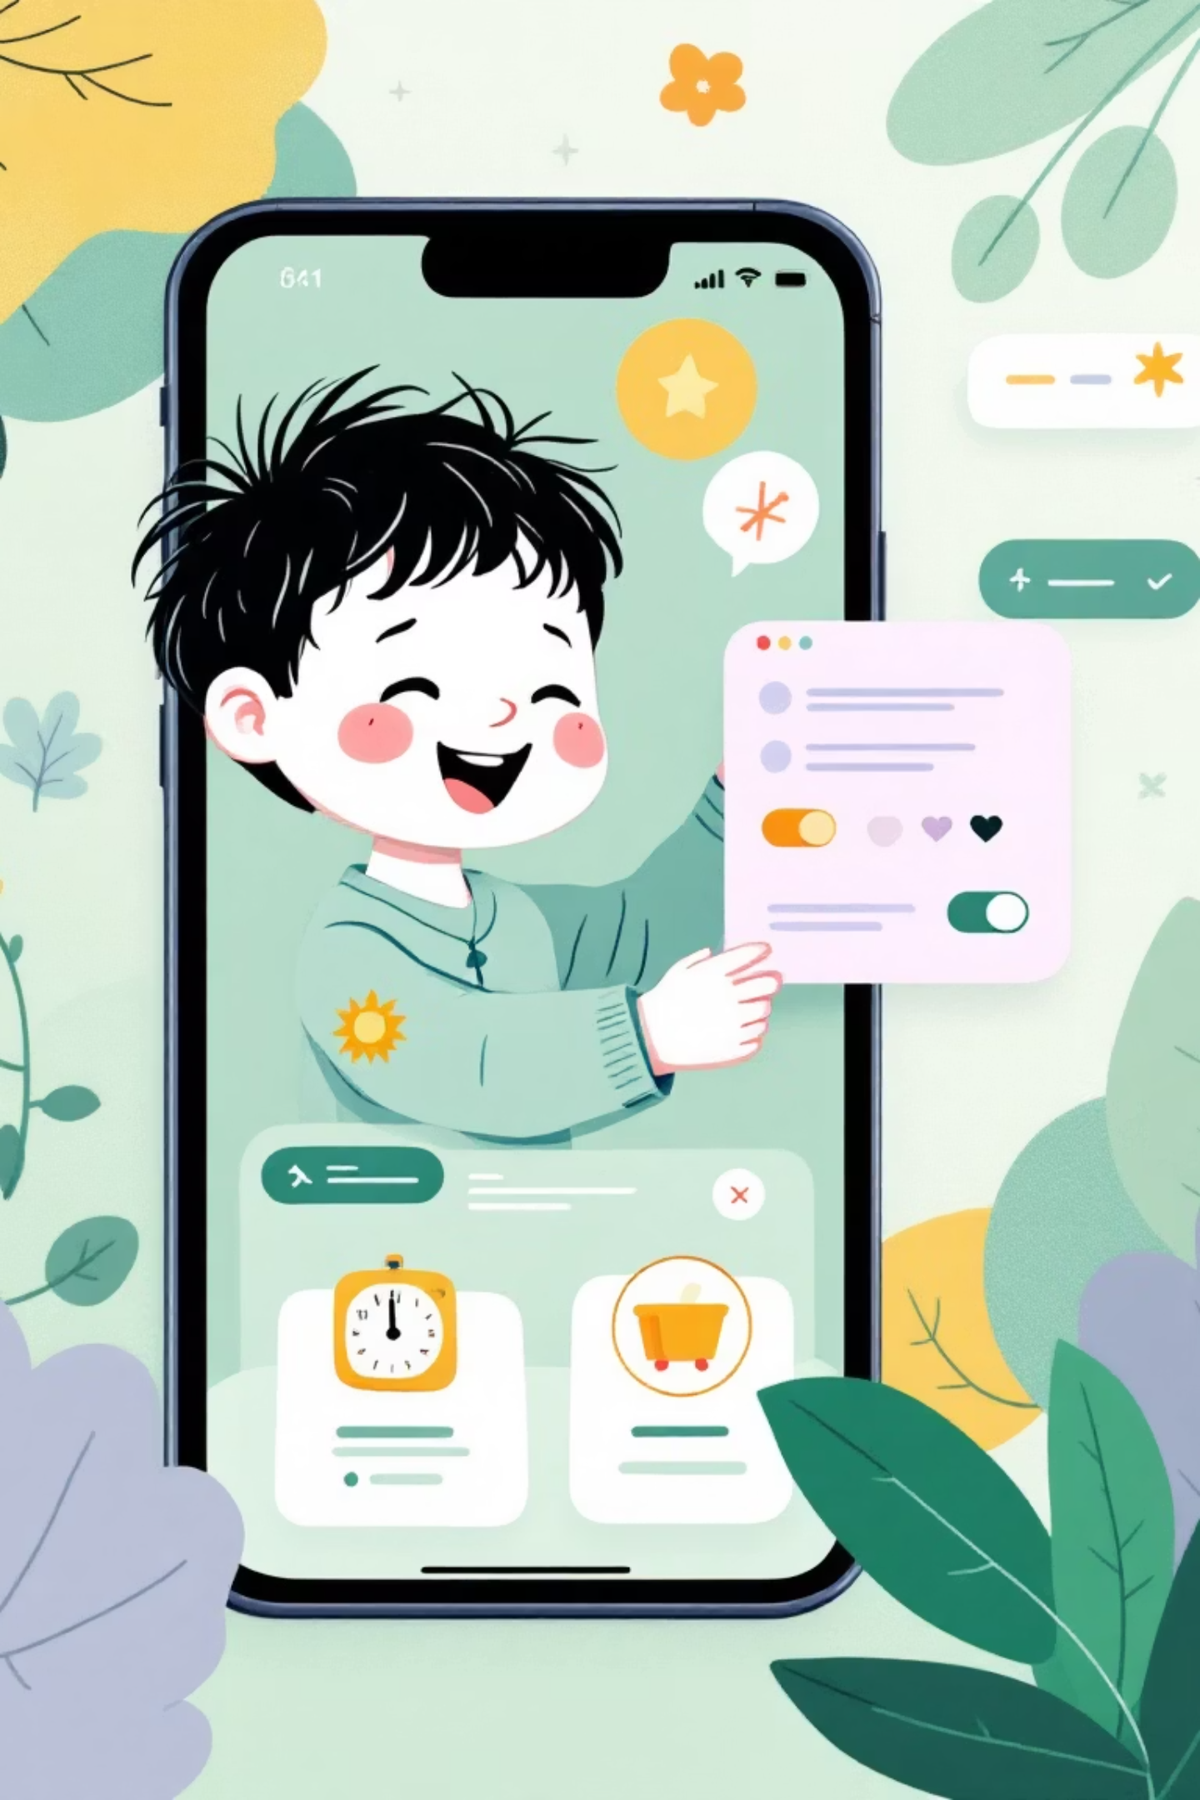
Live Demo: Task Completion Flow
1
Can logs into the system
Sees his personalized dashboard with 3 pending tasks and current point total
2
Completes homework task
Clicks "Mark Complete" button, triggering approval notification to his mother
3
Mrs. Ayşe reviews and approves
Rates the completed homework, awarding points based on quality
4
Can levels up!
Progress bar fills, unlocking new wish items he can now redeem

Slide 10




Project Outcomes and Next Steps
Future Enhancements
Mobile app version for on-the-go access
Social features for sibling competition
85%
Integration with school management systems
AI-powered task suggestions based on age and interests
Child Engagement
Increased task completion rate through gamification
70%
Parental Satisfaction
Improved oversight and reduced daily conflicts
40%
AI Contribution
Code generated by AI tools with human refinement

